Slide 1
8085 Microprocessor
ARCHITECTURE & PIN DIAGRAM

Slide 2
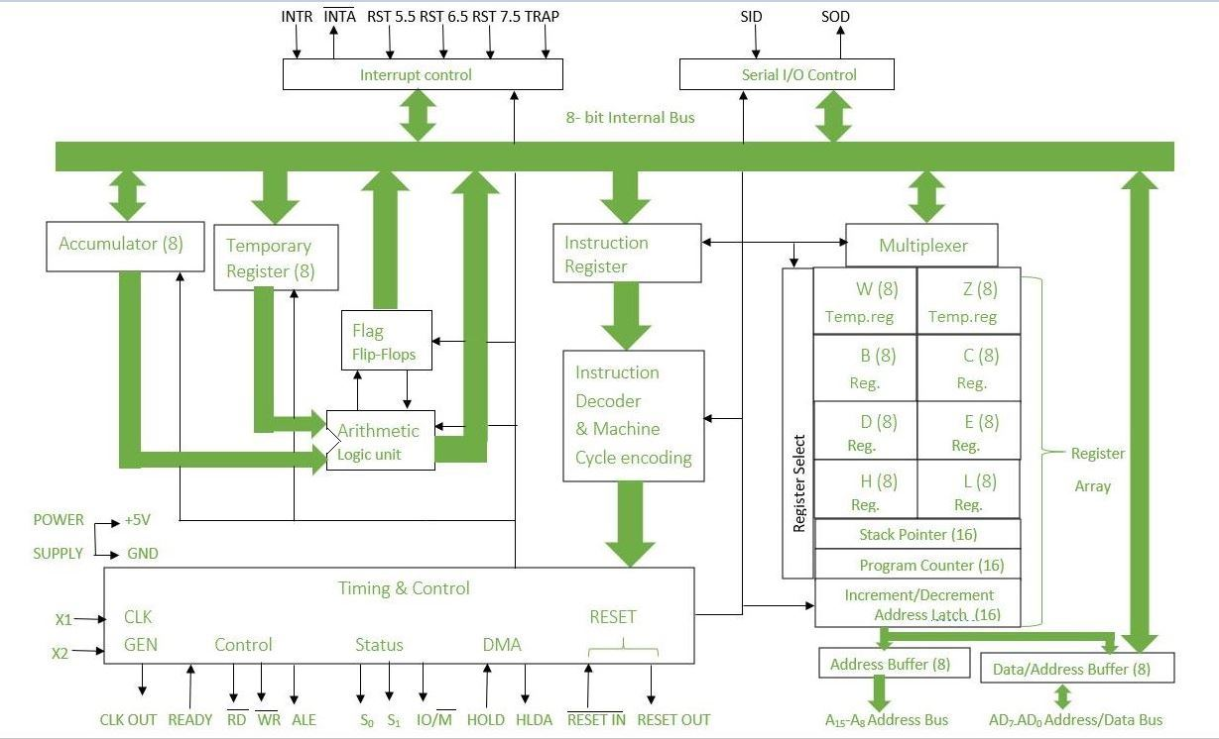
Basic Architecture of 8085 μP

Slide 3
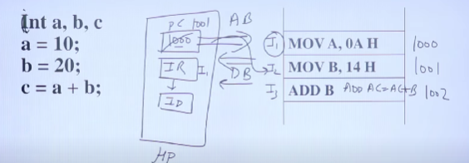

Slide 4
overview
what is a microprocessor?
Pin diagram
Typical structure of MPU(Architecture):
i.Register section
ii.Arithmetic and Logic unit
iii.Timing and control unit
iv. interface section
a)address bus
b)data bus
c)control bus

Slide 5
What is a μP?
A microprocessor is a single chip that contains the main components of a computer’s central processing unit(CPU).
It serves as the brain of the system,performing arithmetic ,logic ,control and input/output (I/0) operations required for program execution.
8085 micro processor: * It is a 8 bit (databus) microprocessor from intel,developed in 1976.
* 40 pin integrated circuit.
* It uses a 5V power supply and operates at a clock speed of 3 MHz.
*The processor supports a 16-bit address bus, addressing up to 64 KB of memory.

Slide 6
Typical structure of 8085 μP(Architecture)
1) Register Section:
a. Registers Accessible to programmers:
i)General purpose registers:(8-bit)
* B,C,D,E,H,L.
* Can be used as 16 bit registers (B-C, D-E,H-L)
ii) Special purpose registers:
* 8 bit: Accumulator, Index Register, Status or flag register.
* 16 bit: PC, Stack pointer.
b.Registers Inaccessible to Programmers:
i)Memory Address Registers(16 bit)
ii) Temporary Register.

Slide 7
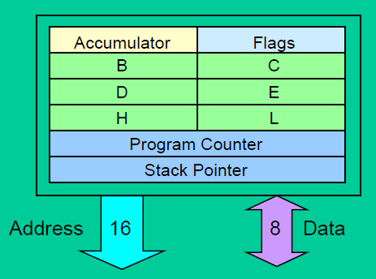
a.Registers accesible to programmers:
i) General purpose registers:
In the 8085 microprocessor, general-purpose
registers (B, C, D, E, H, and L) are 8-bit
registers used to store temporary data during
program execution and can be paired
to perform 16-bit operations.
ii)Special purpose registers:
A) 8 bit :
1) Accumulator:The accumulator in
the 8085 microprocessor is an 8-bit special-purpose register used for arithmetic, logic, and data transfer operations, storing the results of these operations.

Slide 8
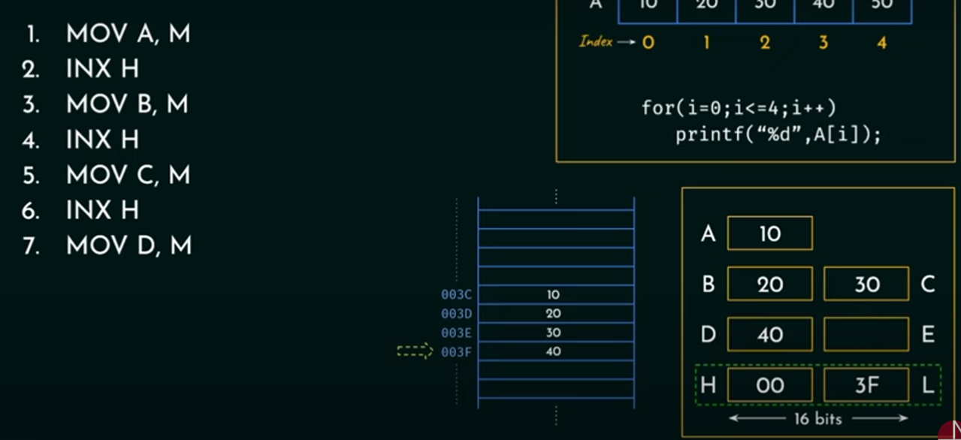
2)Index register:
Indexing in 8085 is implemented using H-L pair registers.
8085 don’t possess a dedicated index register.
denoted as M=[[H][L]]
MOV A,M
INX H
MOV B,M
INX H
MOV C,M
INX H
MOV D,M

Slide 9

3)Flag Register
Cy : if carry generated from MSB during arithmetic operations this field is set to 1.
X : don’t care
P : Parity , if no.of 1’s in
accumulator is even
then it is set to 1.
AC : Auxiliary carry ,if
carry generated from
LS hexadecimal bits
Z: Zero ,it is set to 1, if
accumulator contains
all 0’s.

Slide 10
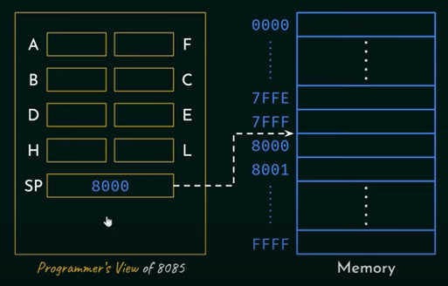
B)16-bit
1. Stack pointer register: The stack pointer (SP) in the 8085 microprocessor is a 16-bit register that holds the address of the top
of the stack which has useful information.
2. Program counter:The program counter (PC) in
the 8085 microprocessor is a 16-bit register that
holds the memory address of the next instruction
to be executed.

Slide 11
b.Registers Inaccessible to programmers
i) Memory address register(MAR):
The Memory Address Register (MAR) in the 8085 microprocessor is a register that holds the memory address of the data or instruction to be accessed.
ii)Temporary register:
The temporary register in the 8085 microprocessor is an internal 8-bit register used by the Arithmetic and Logic Unit (ALU) to hold intermediate data during execution of operations.

Slide 12
2)Arithmetic and Logical unit
purpose | responsible for performing all arithmetic and logical operations required during program execution.
Arithmetic Operations | Addition and subtraction (8-bit and sometimes 16-bit using register pairs).Increment and decrement operations.
Logical Operations | Rotate operations (rotate left, rotate right with or without carry). Compare operations to check equality or magnitude of two numbers.
Interaction with Flags | The ALU updates the Flags Register based on the results of operations.
Temporary Register Usage | The ALU uses the temporary register internally to hold one of the operands or intermediate results during execution.
Integration | The ALU works closely with the Accumulator, which stores the primary operand and receives the result of operations.

Slide 13
3) Timing and control unit
The Timing and Control Unit is responsible for synchronizing all operations in the microprocessor and generating the necessary control signals to coordinate communication between the processor, memory, and I/O devices.

Slide 14
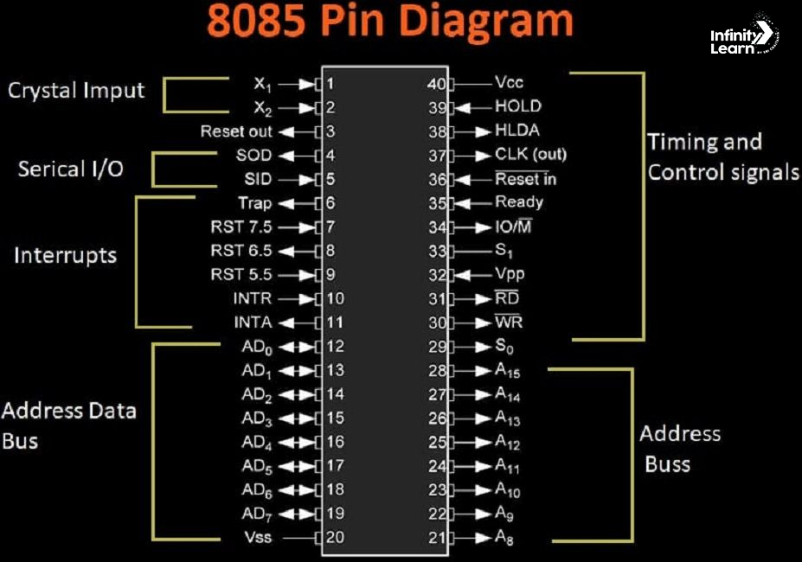
4)Interface section:
i)Address Bus:
It includes the pins
28-21(A15-A8)-->Higher
order bits
19-12(AD7-AD0)-->
lower order bits
Using these 16 bits we can address 2^16 locations(65536)
2^16 =2^6 *2^10
= 64 k
[since k=1024]
it can address upto 64k
memory locations.

Slide 15
ii)Data Bus
It includes pins (AD7-AD0) 19-12 , where AD7 is MSB and AD0 is LSB.
Used for receiving 1) Program code from memory
2)Data byte from an input port or memory.
Used for sending out a data byte to an output port (or )to memory.
These bits can be used both as data bus and lower order bits of Address bus.

Slide 16
iii)Control Bus
a. Memory & I/O control lines:
RD’ and WR’ (31-30):
These are active low inputs.
These signals are outputs from the 8085 microprocessor and are sent to memory or I/O devices to control data transfer operations.
WR’ | RD’ | Function
0 | 1 | AD(7-0) are output pins
1 | 0 | AD(7-0) are input pins
1 | 1 | Internal processing
0 | 0 | micro processor has malfunctioned

Slide 17
...
B. IO (34):
An important control signal used to differentiate between I/O operations and memory operations during data transfer.(output pin)
IO/M' = 0: Indicates a memory operation (read or write from/to memory).
IO/M' = 1: Indicates an I/O operation (read or write from/to an I/O port).
IO | WR’ | RD’ | Description
0 | 0 | 1 | μP writes to memory
0 | 1 | 0 | μP reads from memory
1 | 0 | 1 | μP writes to output port
1 | 1 | 0 | μP reads from input port

Slide 18
...
C. Ready (pin-35):
It is an active high input signal.
The READY pin indicates whether a peripheral or memory is ready to perform a data transfer operation with the microprocessor.
READY = 1: The peripheral or memory is ready, and the microprocessor proceeds with the operation (e.g., read or write).
READY = 0: The peripheral or memory is not ready, and the microprocessor enters a wait state until the READY signal becomes high.
D. ALE(Address Latch Enable) -pin 32:
ALE is an active high output signal.

Slide 19
...
ALE = 1: The lower 8 bits of the address (AD0-AD7) are available on the multiplexed bus, and external latches (e.g., 74LS373) capture this address.
ALE = Low: The bus switches to data mode (for data read/write operations).
E. S0 & S1(29,33-Pins):
status pins are used to indicate various conditions of the microprocessor, such as whether the microprocessor is executing a particular instruction, or if certain operations are being performed.
These pins provide useful signals to external components (like memory, I/O devices, etc.) to help synchronize operations with the microprocessor.

Slide 20
...
IO | S1 | S0 | FUNCTION
0 | 1 | 1 | OPCODE FETCH
0 | 1 | 0 | Memory read
0 | 0 | 1 | Memory write
1 | 1 | 0 | I/O read
1 | 0 | 1 | I/0 write
1 | 1 | 1 | Interrupt acknowledge
0 | 0 | 0 | μP becomes hot

Slide 21
b)CPU &bus control lines
A. (reset in)’ and (reset out) -pins 36,3
reset out is an output pin used to reset peripherals connected to microprocessor.
(reset in)’ is an active low input pin , it sets pc<--0 and clear the buses.
B.Interrupt lines:
i.TRAP- pin 6
Non-maskable interrupt.(Power failure detection,Emergency shutdown systems,Protection against critical hardware faults.)
Highest priority among all the interrupt pins.
A vector address is a specific memory location associated with a particular interrupt. When an interrupt is triggered, the microprocessor automatically transfers control to this address to execute the ISR.
vector address is 0024H, interrupt number is 3.

Slide 22
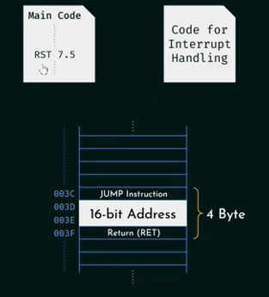
...
ii)RST 7.5, 6.5,5.5:(Pins 7-9)
Maskable interrupts.
RST-restart, cuz instruction will restart if interruption has finished,
vector address: RST 7.5--> 7.5*8=60= 003CH
RST 6.5 --> 6.5 * 8=52= 0034H
RST 5.5 --> 5.5*8=44=002CH
EXAMPLE:When a maskable interrupt occur in
execution of main program, RST 7.5 is activated and
calculates its vector address and using jump
statement it moved to 16 bit address ,where code for
interrupt handling is located.Once interruption is
handled, it returns.

Slide 23
...
iii)INTR (interrupt request) pin-10:
maskable interrupt.
Lowest priority pin among all the interrupt pins.
The microprocessor acknowledges the interrupt request by sending an Interrupt Acknowledge (INTA) signal.
This signal informs the external device that the microprocessor is ready to handle the interrupt.
iv)INTA’ (interrupt acknowledge) pin 11:
An external device sends an interrupt request through the INTR pin.
If interrupts are enabled and the microprocessor is ready, it responds by activating the INTA signal during the next machine cycle
The external device, upon receiving the INTA signal, places the corresponding RST instruction (Restart instruction) on the data bus.
This instruction determines the vector address for the Interrupt Service Routine (ISR).
The microprocessor reads the RST instruction, jumps to the appropriate vector address, and begins executing the ISR.

Slide 24
...
C. DMA Signals:(38,39 pins)
i)Hold:The HOLD pin in the 8085 microprocessor is an input pin that allows external devices to gain control of the system buses (address bus, data bus, and control bus).
ii)HLDA:The HLDA (Hold Acknowledge) pin in the 8085 microprocessor is an output pin used to indicate that the microprocessor has acknowledged a bus request made through the HOLD pin and has relinquished control of the system buses (address, data, and control buses).

Slide 25
c)Utility control lines
i. VCC and VSS Pins(40,20):
vcc --> +5V DC
vss--> ground
ii.x1 &x2, CLK out pins(1,2,37):
x1,x2 are clock input signals responsible for operating frequency of microprocessor.
through x1,+5v is applied and is resonates the quartz whose natural frequency is 6MHz and outputs 3MHz and this is input to our micro processor.
clk out provides a timing reference for various components.

Slide 26
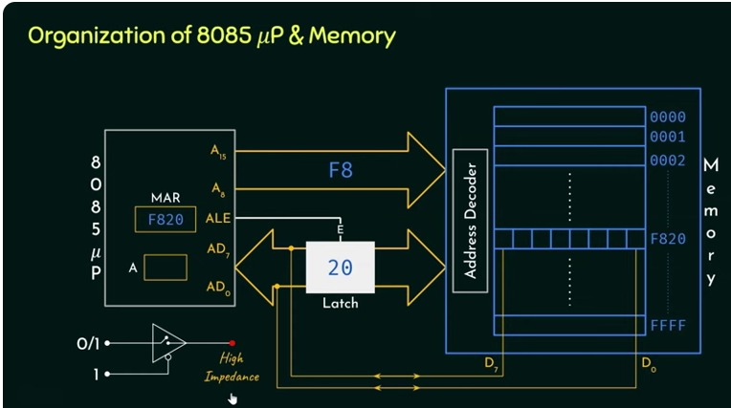
data transfer between processor and memory

Slide 27
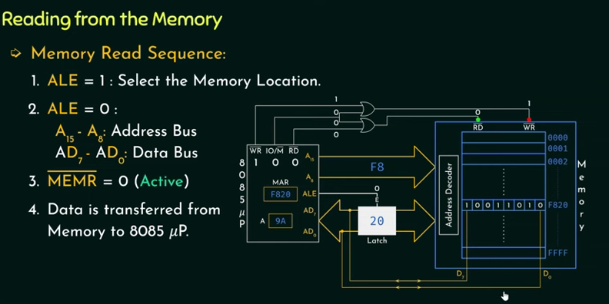

Slide 28
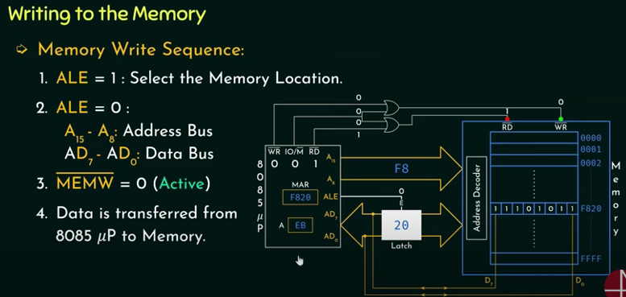

Slide 29


